Slide 1

A Reactive Online Optimization Based Whole Body Contol for Quadruped Locomotion Over Challenging Terrain
[CE554] Mechanical Design of Civil Robot
Team 2
20185570 - Hong Seung woo
20183633 – Choe JongHun
September 19, 2018
Notes:
첫 페이지

Slide 2
Table of Contents
Literature Review
Research Topic
Research Plan
Future Work
Notes:
목차

Slide 3
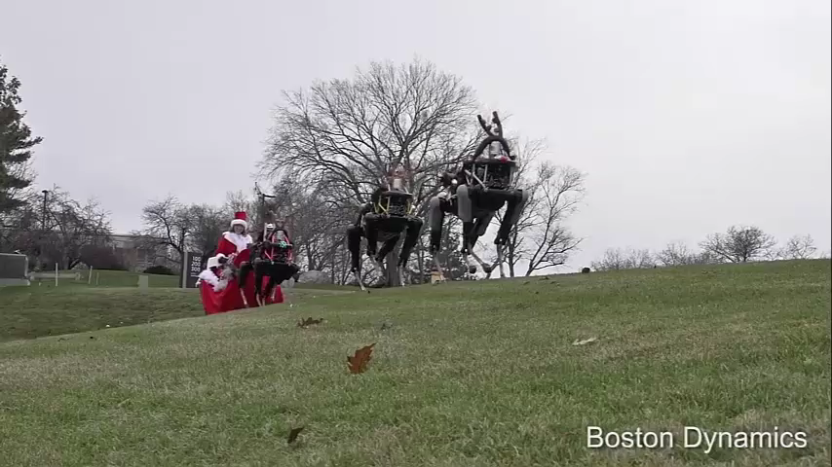
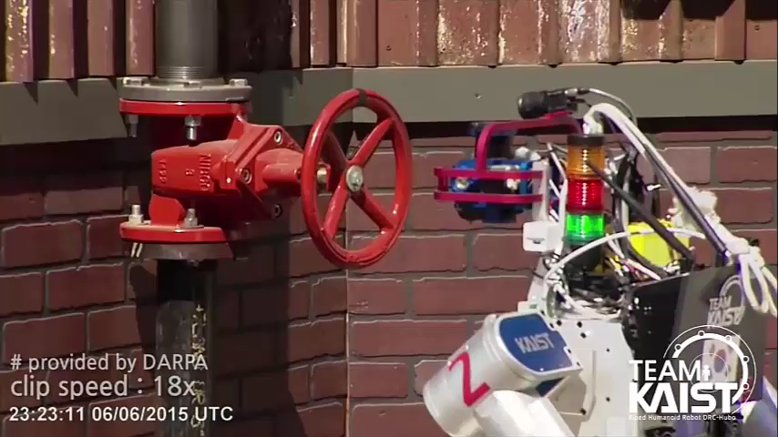
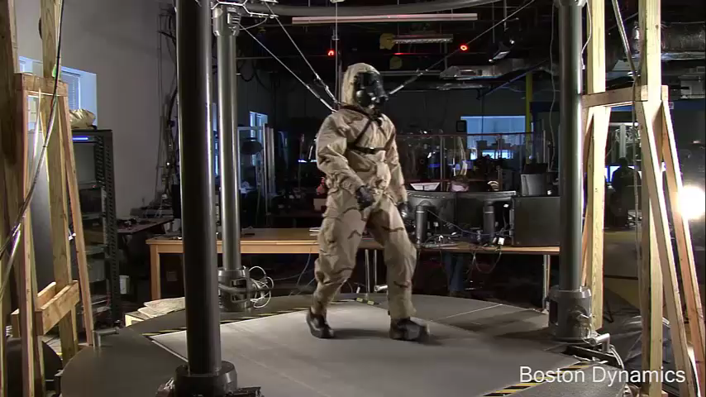
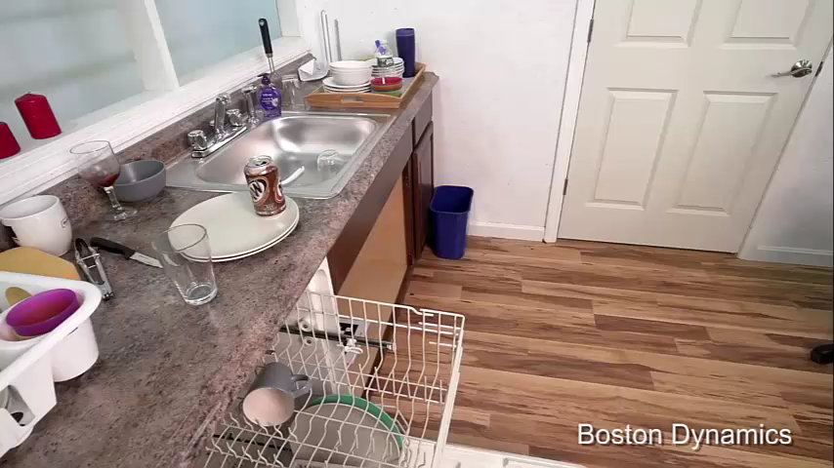
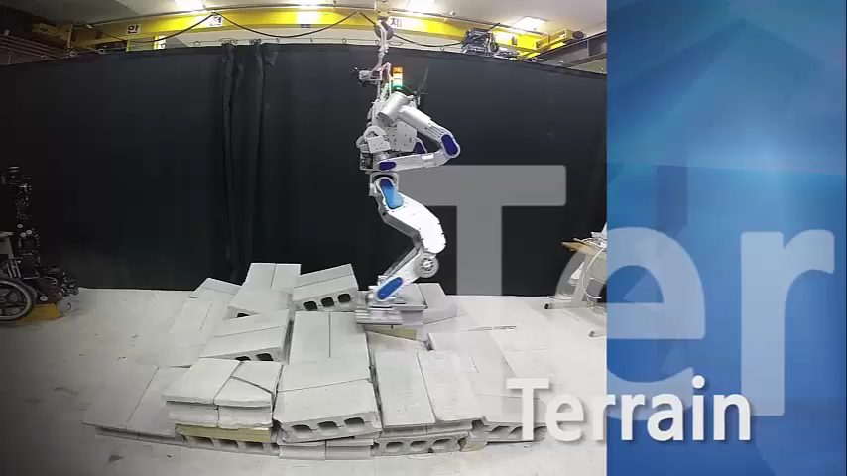
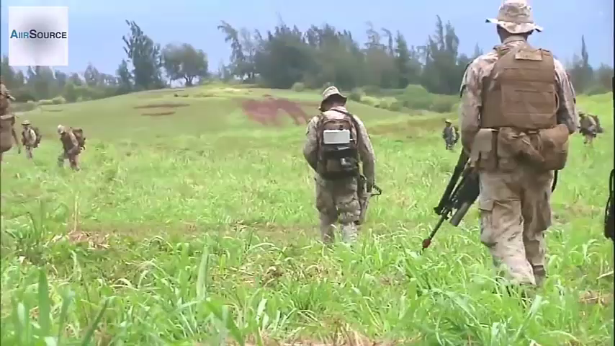
1. Motivation
Applications of (Legged) Robot
- Personal service
- Disaster relief
- Military
Requirement: Reliable Motion Control
Personal Service
Disaster Relief
Military

Slide 4
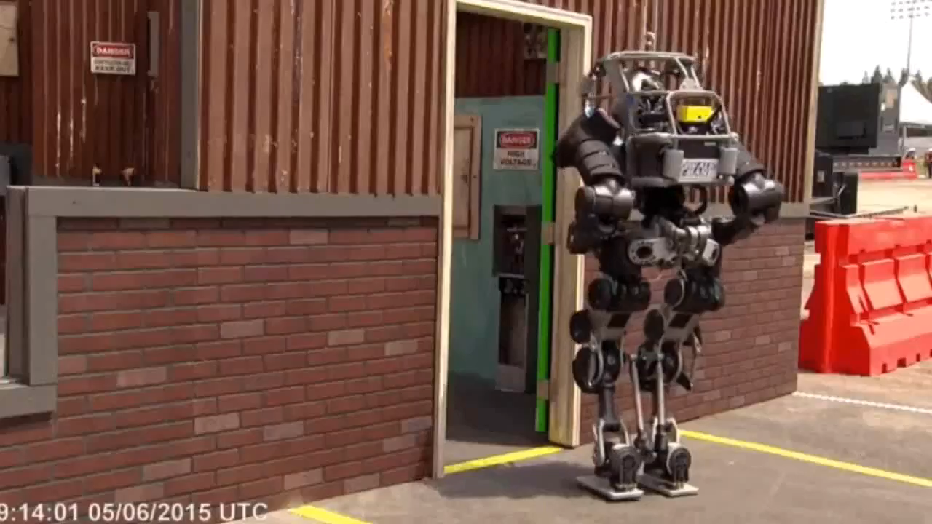
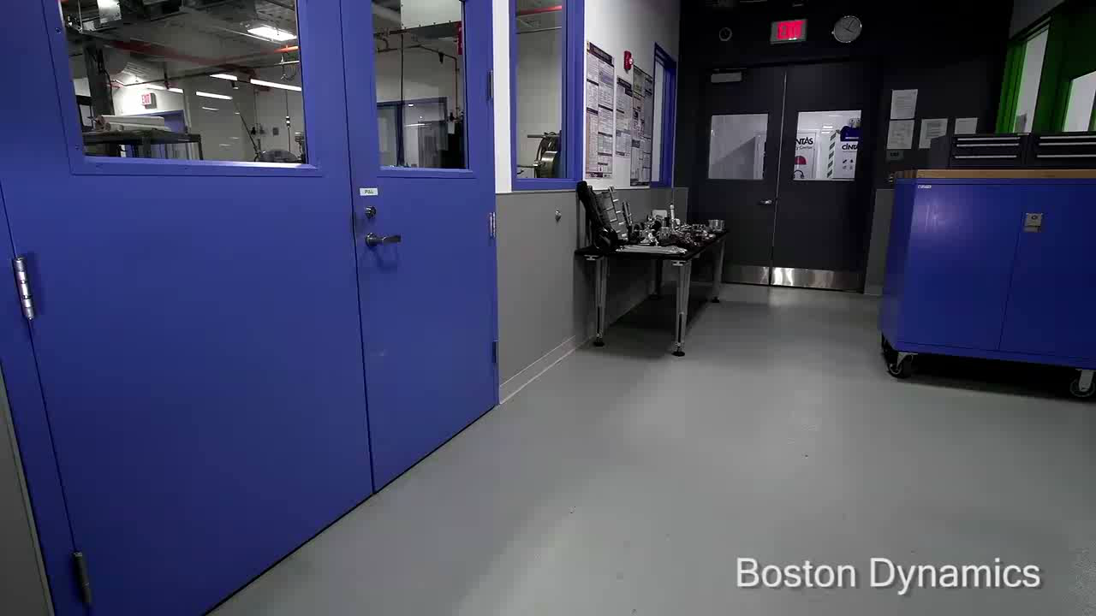
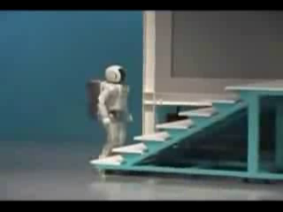
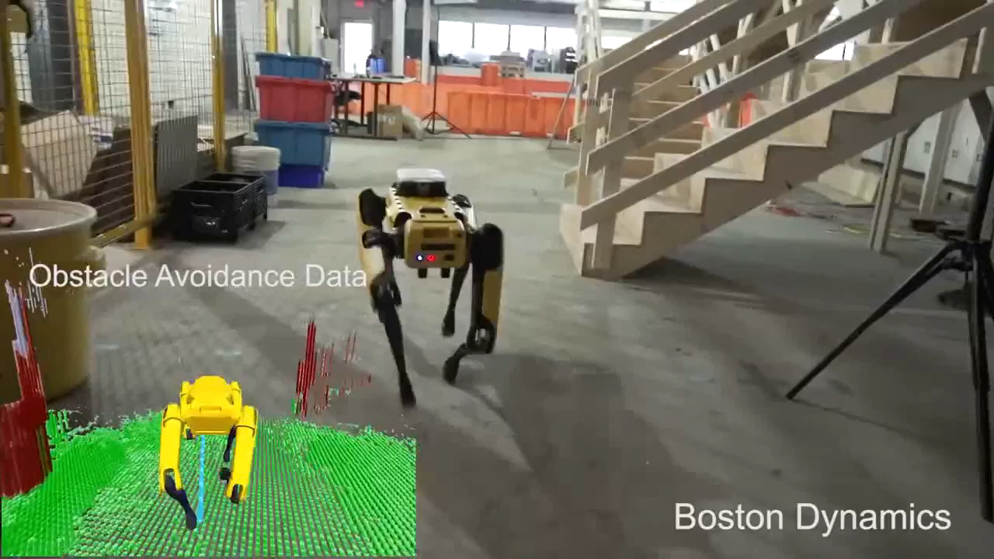
1. Motivation
Bipedal vs. Quadrupedal
- Stable
- Heavy payload
Recommendation: Quadrupedal
Reliable, Quadrupedal Robot Motion Control
Notes:
Stable: 다리가 4개이므로 기본적으로 bipedal보다 안정적, 통신이 끊기거나 갑작스러운 전원 차단에도 로봇의 com이 support polygon 바깥으로 나갈 확률이 적음.

Slide 5
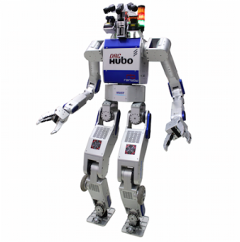
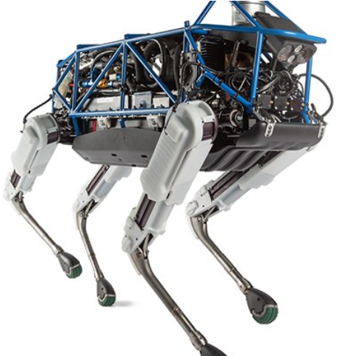
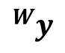
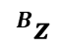
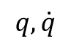
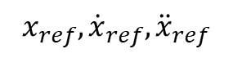
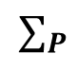
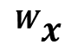
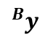
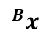

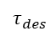
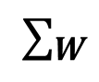
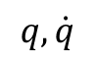
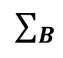
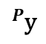
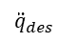

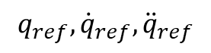
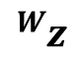
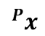
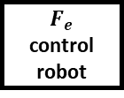
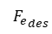
2. Overall Robot Control Framework
$$q, \dot{q}$$
High-level controller
$$x_{ref},{\dot{x}}_{ref},{\ddot{x}}_{ref}$$
$$q, \dot{q}$$
Low-level controller
$$q_{ref},{\dot{q}}_{ref},{\ddot{q}}_{ref}$$
$${}_{ }^{W}z$$
Plant
$${}_{ }^{W}y$$
$${}_{ }^{W}x$$
$${\ddot{q}}_{des}$$
$$τ_{des}$$
$${F_{e}}_{des}$$
$$∑_{W}$$
$$∑_{B}$$
$${}_{ }^{B}{z }$$
$${}_{ }^{B}{y }$$
$${}_{ }^{B}{x }$$
$$φ$$
Position control robot
Torque
control robot
$$F_{e}$$
control robot
$${}_{ }^{P}{\text{y} }$$
$${}_{ }^{P}{x }$$
$$∑_{P}$$
$$θ$$

Slide 6
2. Literature Review: HLC
Notes:
(줄바꿈은 애니메이션을 의미)
로봇이 있다.
무게중심을 표현할 수 있고,
이를 하나의 inverted pendulum으로 생각할 수 있다.
로봇의 발 개수 만큼 inverted pendulum을 생각해보자.
이렇게 inverted pendulum으로 세운 로봇의 근사 모델을 ‘LIPM’이라고 한다.

Slide 7
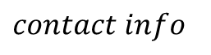
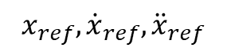
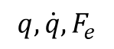
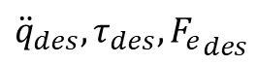
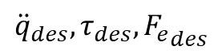
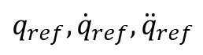
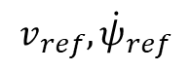
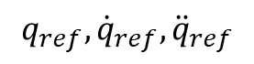
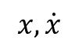
2. Course Topic – Trajectory Optimization
Block diagram of motion control framework
$$v_{ref},{\dot{ψ}}_{ref}$$
$contact info$
Reference Generator
Optimization Based
Motion Controller
$$q_{ref},{\dot{q}}_{ref},{\ddot{q}}_{ref}$$
$$x, \dot{x}$$
$$x_{ref},{\dot{x}}_{ref},{\ddot{x}}_{ref}$$
Inverse Kinematics
Constraints
Desired behaviors
State
Estimator
$$q_{ref},{\dot{q}}_{ref},{\ddot{q}}_{ref}$$
Optimization Based Motion Controller
QP solver
$${\ddot{q}}_{des}, τ_{des}, {F_{e}}_{des}$$
Plant
Position control robot
Torque
control robot
$$F_{e}$$
control robot
$${\ddot{q}}_{des}, τ_{des}, {F_{e}}_{des}$$
$$q, \dot{q},F_{e}$$

Slide 8
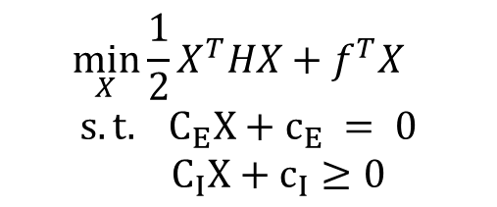
2. Course Topic – Trajectory Optimization
Quadratic Programming
- Optimize the general cost function
$$\min_{X}{\frac{1}{2}X^{T}HX+f^{T}X}$$
$$s.t. C_{E}X+c_{E} = 0$$
$C_{I}X+c_{I}≥0$
Cost function
Cartesian space acceleration
Joint space acceleration
Weight distribution
Center of Pressure tracking
Direct tracking and regularization
Equality constraint
Dynamics
Contact constraint
Inequality constraint
Friction cone
Center of Pressure

Slide 9
3. Future Work
Optimization based motion controller design:
- Model: Full model or Reduced model
- State: Full state or Reduced state
- Cost function: desired behaviors to be optimized
- Equality and inequality constraint: actuator bounds, no foot slipping
Select appropriate Quadratic Programming solver
Test on full-body simulator

Slide 10


Slide 11
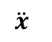
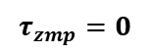
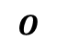
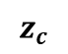
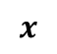

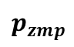
Appendix
Reduced model vs. Full model
Reduced-Model Controller
Full-Model Controller
$$\ddot{x}$$
$$M$$
$$z_{c}$$
$$τ_{zmp}=0$$
$$O$$
$$p_{zmp}$$
$$x$$

